Slide 1
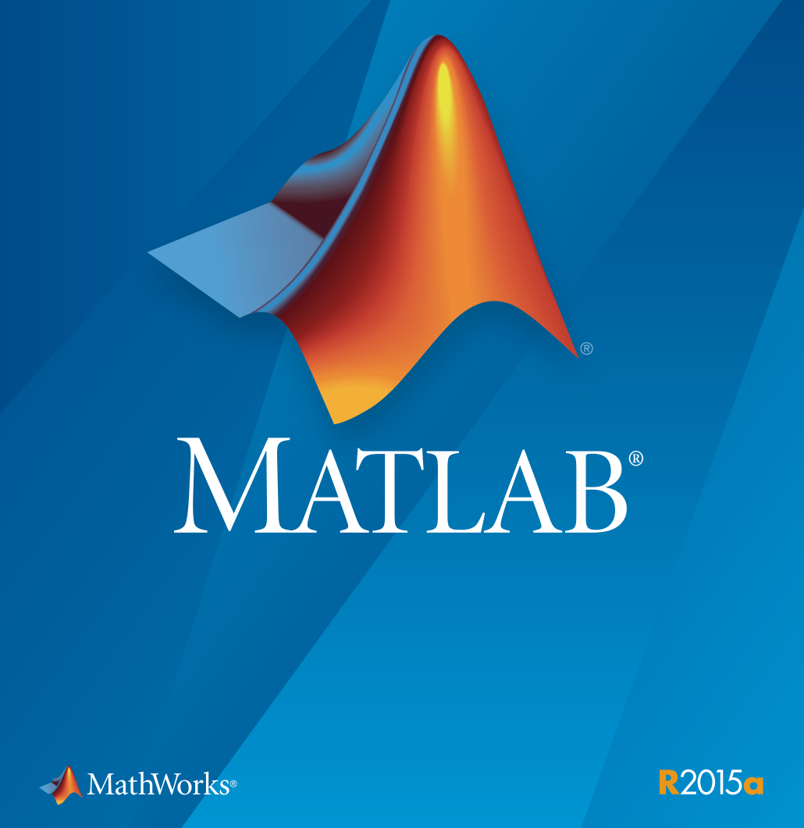
Matlab Refresh Evening

Slide 2
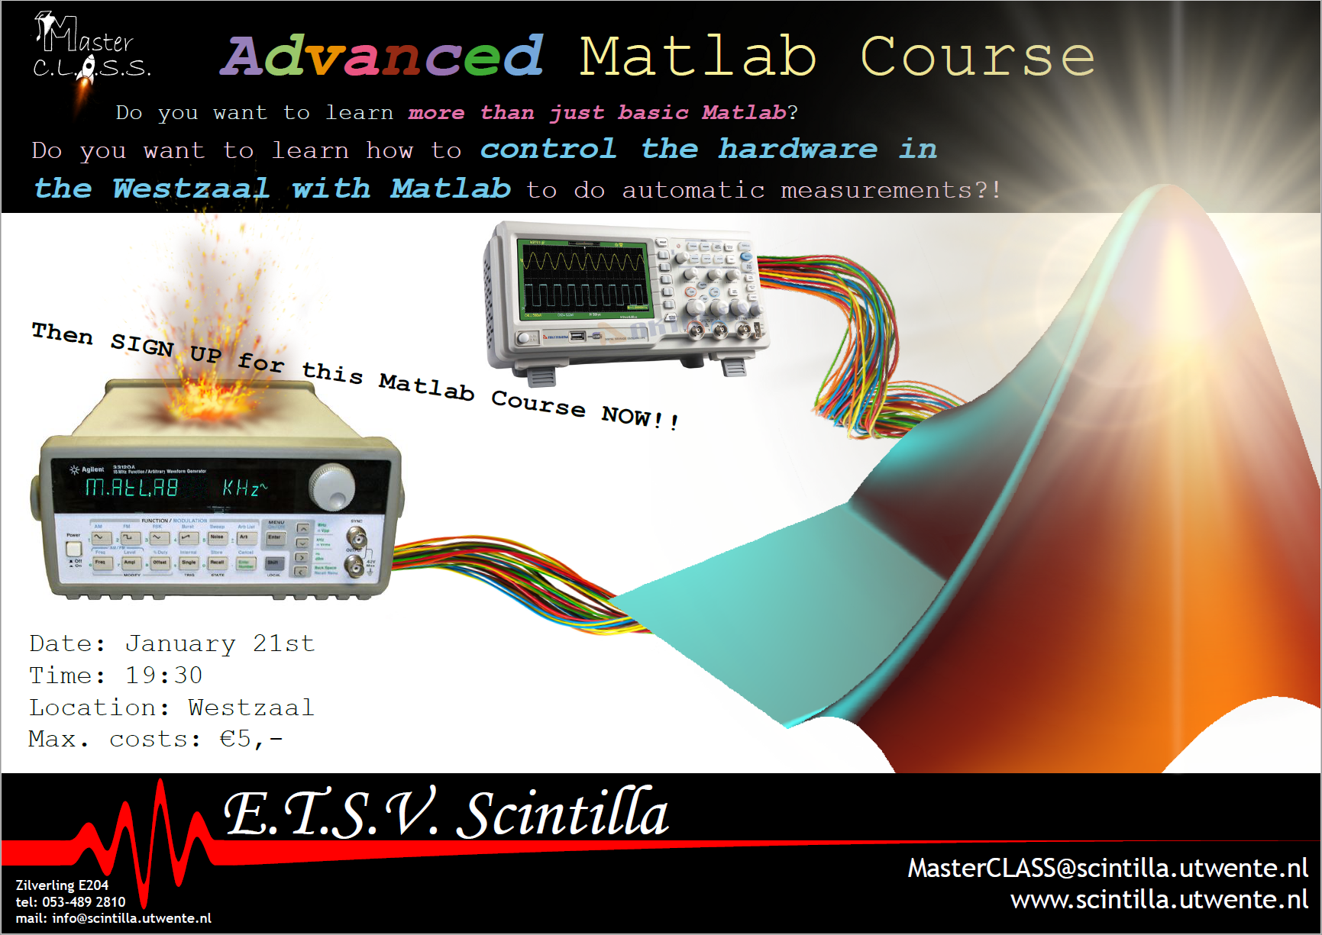
This course
This is day 1
  Presentation
  Do stuff
Day 2 will be much more epic
  But no pizza….

Slide 3
What is Matlab?
Calculator on steroïds
Multi-pardigm numerical computing environment
Can do advanced stuff like
  Image processing
  Deep learning
  Make graphs of cows

Slide 4
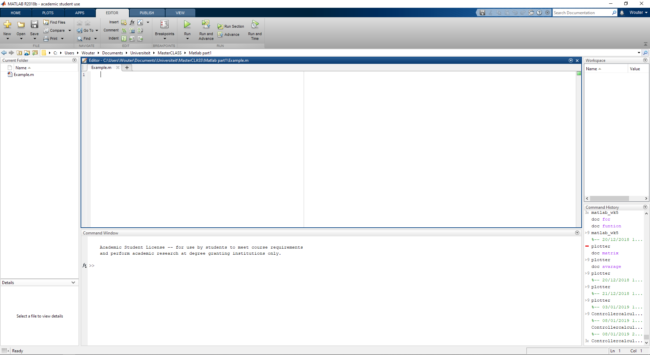
Interface

Slide 5
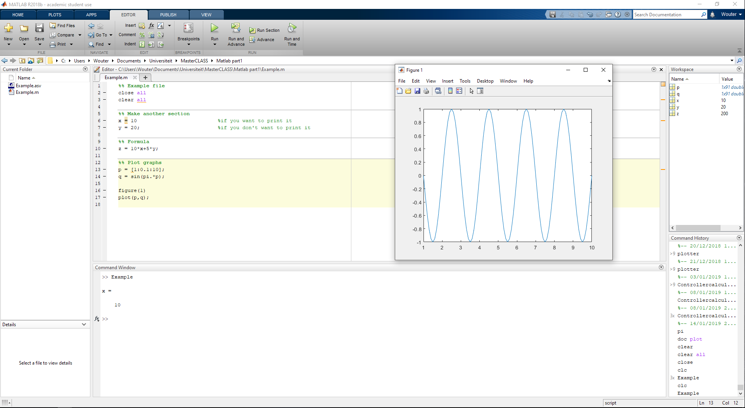
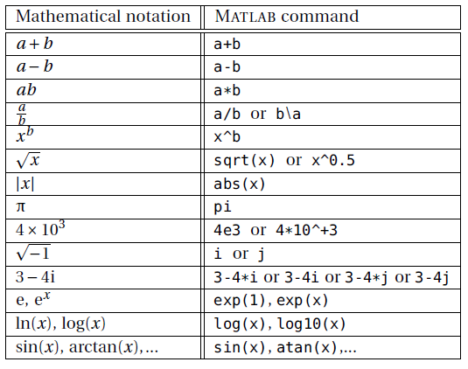
Syntax
Semicolon ;
Commenting %
Variables
Formula’s
Plotting

Slide 6
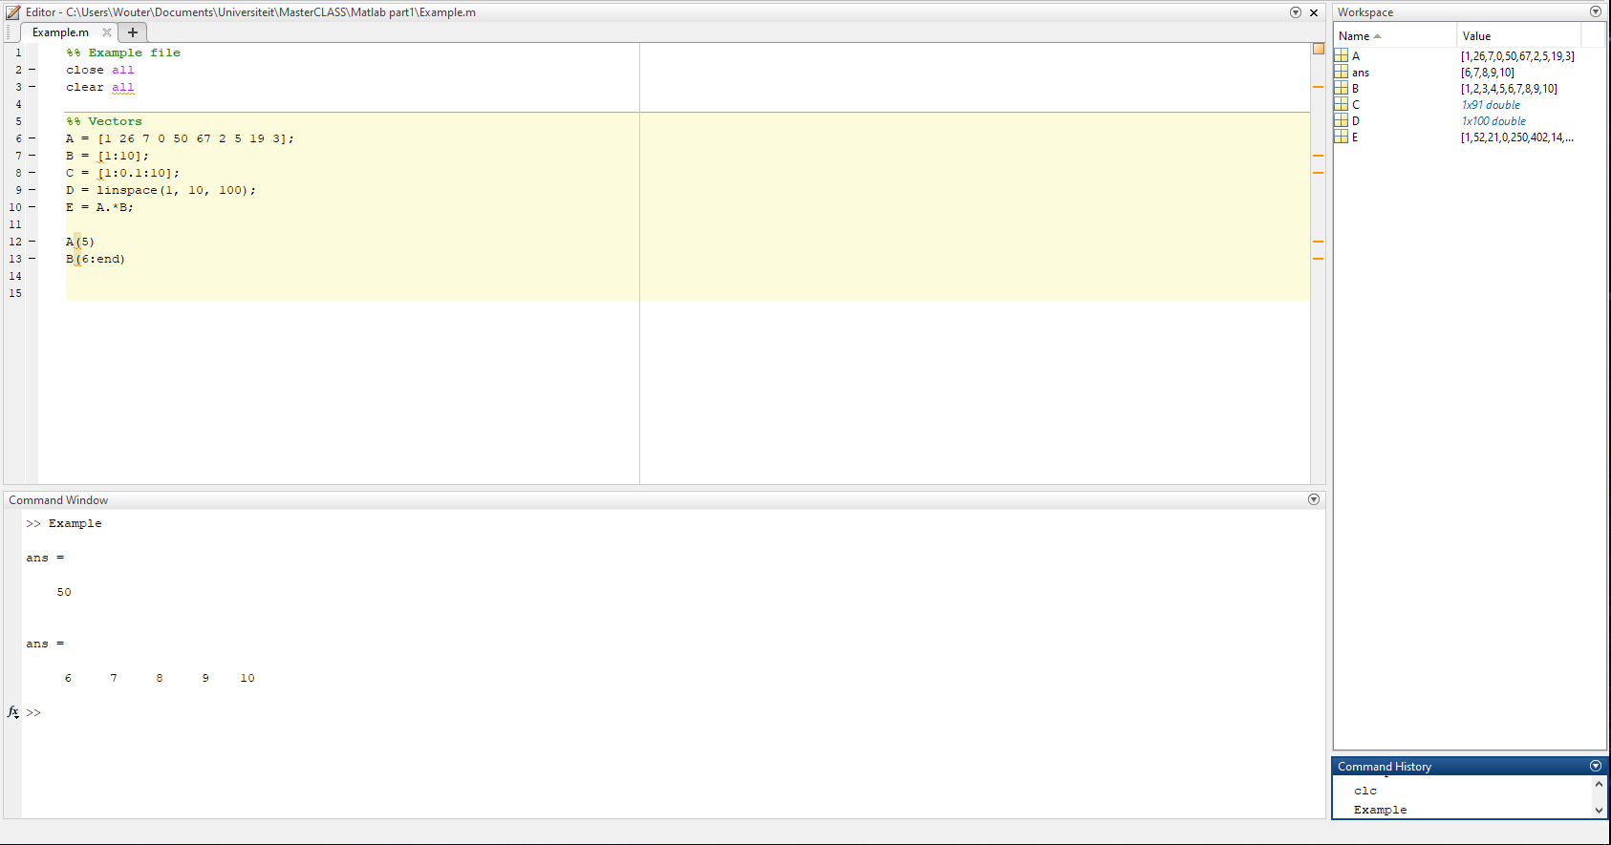
Vectors (and Matrices)
Matlab indexes from 1 (unlike other programming languages)
A = [ 1 26 7 0 ]
A = [1:10]
.. :0.1: .. and linspace
Difference * and .*
Accessing elements
  A(5)
  A(3:end)
  A(:)

Slide 7
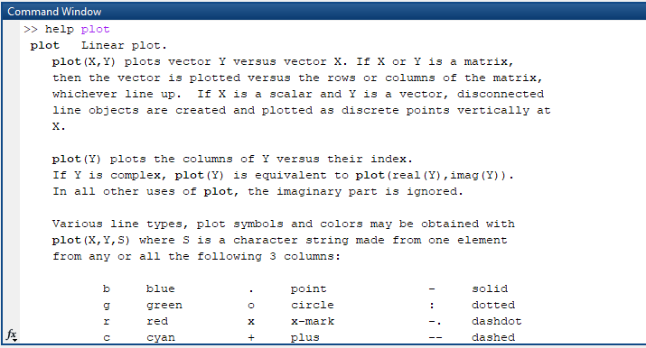
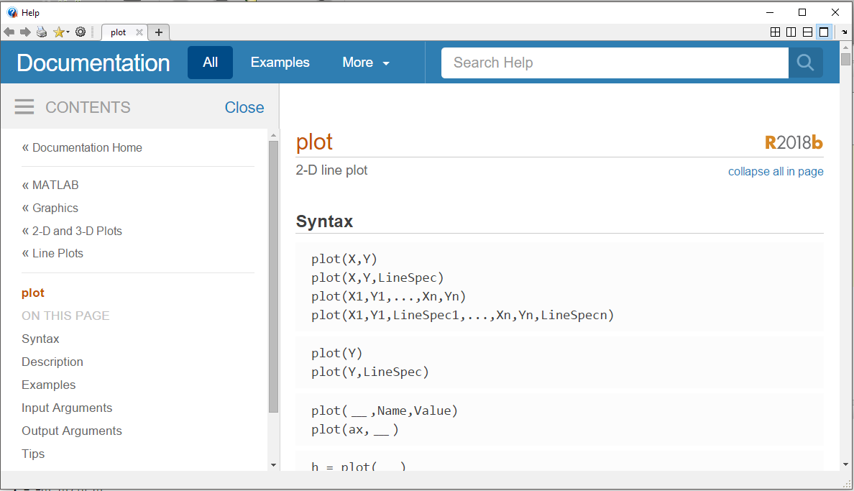
Important!
Help – function
DOC – function
Google is your friend

Slide 8
What to do?
There are three options
The Scintilla Matlab manual; digital; some explaination of basics; excercise of varying difficulty
Matlab manual of Applied Mathematics; extensive information; excercises per chapter
Signal assignments of the first years
You can find everything on here:
https://docs.scintilla.utwente.nl/masterclass/MatlabCourse2018/Part1

Slide 9
Demo

Slide 10
Practice
Have fun!
Work together on assignments
Or be inventive!

